Slide 1

New Frontier for Electricity Cost Saving in Mexico
Presented by Electric Foresights
Andres Zamora
Jason Kang
Pavel Golukhin
Steven Lin
Notes:
Jason
Good evening ladies and gentlemen. We are a team of data scientists from Electric Foresights. Tonight, we are very pleased to present to you the new frontier for the electricity cost saving in Mexico.

Slide 2
Traditional electricity cost saving focus on consumption control
1. Consumption cutting
2. Energy audit
Cost Savings
3. Power recycling
Notes:
Jason:
Over the past, big electricity users like data warehouse and manufacturers have done a very good job coming up with numerous brilliant ways to control electricity consumption.
However, most of them have come to the realization that they are approaching the ceiling for consumption control. So the million dollar question is that is there further room for electricity cost saving?
To answer the question, we have to resort to the most basic equation of the electricity cost.

Slide 3
Price — the Missing Puzzle!
Electricity Cost = Consumption X Price
Notes:
Jason:
There are two components for the electricity cost -- the consumption and the price! In the past, we have focused too much on the consumption side while giving little attention to the price element. It then appears that the key to unlock further cost savings is found in price.
To find out the key, we have to first understand what electricity pricing mechanism in the Mexico Day-ahead market.

Slide 4




How is the Price Determined?
Users submit daily demand a day before the actual usage
01
Suppliers submit price and their respective capacity
02
Regulators fills the demand by matching the suppliers in ascending order based on their price submitted
03
Usually clean energy suppliers will be matched first due the low variable cost, and traditional power plant will be the last matched due to the high fuel cost.
04
05
The price offered by the last matching supplier will be the price of the electricity.
Notes:
Jason
And this is how the price is determined in the Mexico market.
….
….
Upon knowing the pricing mechanism, we can now find out the factors affecting the price.

Slide 5
A Breakdown of Variables that May Impact Price
Price
Who is the Last Supplier
It’s Submitted Cost
Demand and Capacity
No. of Users
Weather
Time
No. Suppliers
Fuel Cost
Exchange Rate
Bidding Strategy
Op-Cost
Notes:
Andres
Here is a structured view of variables that may impact price.
Price depends on who is the last supplier and it’s submitted cost. The last supplier is determined by the demand and the capacity of the market, so the cheapest generator is the first one to enter and in that order the most expensive one is the last, and what ends up affecting the price is the number of end user, the weather, the time of day and the number of suppliers also factor into the day ahead spot market electricity price. This price is also determined by the submitted cost of the last matching supplier it’s fuel cost, the local exchange rate in this case pesos to dollars, the bidding strategy used by the last matching supplier, and the operational cost of the last matching supplier. Now I’m going to talk about why there are no established solutions in mexico.
Last sentence: Now I’m going to talk about why there are no established solutions in mexico.

Slide 6

The Pain Point of Current Solutions
1. Variable
Price is not a stand alone variable
2. Complexity
It depends on so many factors aforementioned
3. Limitation of Model
Statistical measure focusing solely on price doesn’t work very well (ARIMA) due to omitted variable bias.
Notes:
Andres
The reason why current solutions don’t work well to forecast price a week-ahead in an hourly frequency is because price is not a stand alone variable, it depends on several factors. Price is the aggregate impact of so many different underlying variables if we only use price through ARIMA or Prophet models we suffer from omitted variable bias
Last sentence:3rd point there are so many factors affecting price that
Price is the aggregate impact of so many different underlying variables if we only use price we suffer from omitted variable bias

Slide 7

Our Solution
Autoregressive Recurrent Neural Networks to capture the subtle interactions among various factors affecting the price
Automated Pipeline to gather input variables from multiple sources and generate the most updated hourly forecast 7 days ahead
Notes:
Steven
Thank you Andres for walking through the limitation in traditional forecast method,
Here at Electric Foresights, we have a solution to boost up the accuracy of the hourly electricity price forecast, which is a key component for user to estimate their total electricity cost accurately.
We achieve better accuracy by utilizing autoregressive recurrent neural networks. This model can capture the subtle interactions among various factors affecting the price.
In addition to a robust model, we feed in the most relevant and updated data by setting up an automated data pipeline to scrape latest data every day from 5 different web sources which encompassed 14 different features.
We will walk through more technology detail in shortly.

Slide 8
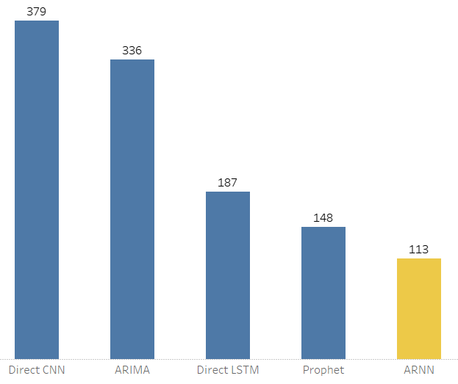
Model Evaluation
Mean Absolute Error (MAE) to measure the unscaled absolute difference between actual and forecast value which is less impacted by outliers
Mean Absolute Error
Winner:
Autoregressive RNN !
Learn More
Notes:
Steven
To evaluate different models, we choose Mean Absolute error which measures the unscaled absolute difference between actual and forecast value, which we believe it provides more fair assessment to minimize overall error. The autoregressive RNN is the clear winner comparing to other neural network model and the popular traditional time series model ARIMA.
(Switch to the “Inside the Crystal Ball”) And this is due to the complexity of the problem, to make our point, let’s compare the time series line plot of several input factors to the Electricity price we are predicting (at the bottom). We see there is noticeable correlation between temperature and electricity price. However, the correlation with crude oil and exchange rate are more subtle, so many machine learning algorithms we tried couldn’t make use of these features. On the other hand, traditional time series model such as ARIMA use only the historical price to predict future price. However, that fails to encompass other determining factors that affecting the price. Therefore, we utilize Autoregressive RNN, a cutting-edge deep learning algorithm that is able to capture the complex relationship among various factors to improve the accuracy. We have learn a lot from this project, and we’d like to share with you some key takeaway.

Slide 9




Key Takeaway
Model
01 Identify underlying factors
02 Neural networks to capture
non-linear relationships
03 No one model fits all
Infrastructure
01 End-to-end AWS infrastructure is scalable and easily customizable
02 AWS Lambda and Cloudwatch to make it super cost-effective
CloudWatch
Notes:
Some Key takeaways on the model building:
There could be many underlying factors affecting the variable you want to predict. It is very important to identify them and make use of them to reduce the bias and thus improve model performance
Neural Networks is better at figuring out the subtle non-linear relationships among many variables
There’s no one model fits all solution, we have to try the cocktail approach in order to find the one that works best.
Lastly, some takeaways point regarding the data infrastructure:
We build our end-to-end infrastructure on AWS from web scraping to the final dashboard on web server, the cloud computing is really convenient, cost effective, and reliable. It allows us to start with cheapest server and then upgrade to a more advanced server when we find out we need to run resource intensive deep learning algorithm, just with few simple clicks.
We utilize AWS Lambda to run script only when we need it, and use AWS Cloudwatch to trigger the lambda function at the right time which cut down the cost to become less than 5% of the original cost.
Next Pavel will demo our product.

Slide 10
Product Demo
Electric Foresights
Forecast Dashboard
Check It Out!
Notes:
Pavel
This dashboard demonstrates what kind of information can a user expect. The most prominent chart shows the hourly electricity price for the selected region. The solid line indicates historical actual price, whereas the dotted line indicates the predicted electricity price generated by the ARNN model running at the backend server. Users can zoom in on the chart to see the hourly trend, and they can conveniently zoom out by double click.
Currently, we only launched prediction for Monterrey region which is the condensed industry hub in Mexico. We plan to launch other regions according to clients’ need in the future.
Besides the interactive chart, we also offer summary table which quickly highlights the predicted daily average, a useful piece of information that helps if our client want to adopt flexible work schedule. It also offers the peak hours and off-peak hours which helps a client to implement peak shavings.
In addition, our client can get the complete prediction results by clicking on the download button, which saves the predictions as a csv file.
Please take note that this dashboard is for demonstration purpose. In production, we will offer API access to help our client integrate the price intelligence with their existing system for automated decision making.

Slide 11
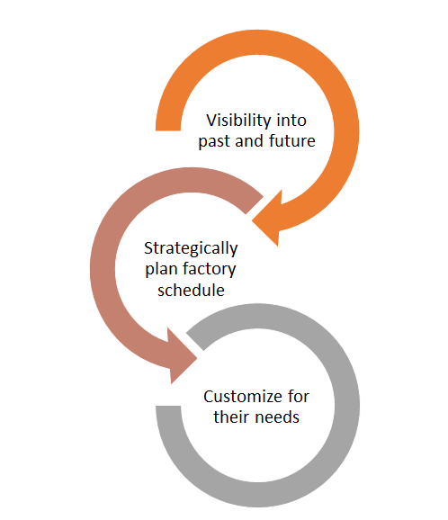
What our product means to you ?
Our product provides insights into the future
The foresights enables a brand new array of cost-saving strategies
Alternative operating schedules
Targeted peak-shaving
Optimization of the power storage solutions
Strategic engagement of the backup power source or co-generation
And more...
Notes:
Jason
Now you know that our product is a crystal ball that unveils future electricity price, so what does it mean to your business?
A well known saying goes knowledge is power. The forecast of future electricity price unlocks a new arsenal of cost-saving tools.
For instance……
,... and a lot more.
Here we are going to use a case study to demonstrate to you the amount of saving power our product offers by simply leveraging on the first two strategies - Alternative operating schedules and Targeted peak-shaving.

Slide 12
Use Case Demo -- Client Information
Client Name: Teleflex
Business: Manufacturer of Medical Equipments
Operating Days: Mon to Fri
Operating Hours: 24 hrs
Hourly Consumption: 3.55 MW/h
Max Consumption Cutting Rate: 70%
Maximum Hours to Practice Consumption Cutting: 6 Hrs.
Need to Catch Up During Off-Peak Hours: No
Notes:
Jason:
Please allow me to introduce to you one of our potential clients.

Slide 13
Use Case Demo
Click on the following link to find out how much you can saving by using our product:
Electric Foresights
Case Demo and Savings Estimator
Check It Out!
Notes:
Jason:
Now let’s take a look at how our product can benefit this client.
Before we proceed further, let’s understand how the two cost saving strategies work.
The alternative work schedule is implemented by shifting client’s operations to the days with the least predicted average cost in the week. Noted that the least cost days of the week may differ from time to time.
The peaking-shaving strategy is implemented by moving a portion of the peak hours' power consumption to a number of off-peak hours, in order to cut down peak hour costs without sacrificing the total consumption amount. However, in certain cases, client may not need to catch up the power consumption in off peak hours, instead, they just want to identify the peak hours to cut down consumption, which is the exactly the case of this client.
Now, all we need to do is to pick the operating days and enter the information according to our client’s current situation and click on View Savings.
The grey bar represents the original electricity cost when taking no actions at all.
Orange bar indicates the actual cost if the client only practices alternative work scheduling based on the model prediction, you can see that the operations on day 1 and day 4 are moved to day 5 and day 6.
green bar indicates the cost if client only practices peak-shaving.
The purple line indicates the cost if the client were to practice both.
At the bottom, we can directly see the total amount of savings. In this case the client would probably save 4.3 million dollars by practicing just two of the many cost-saving strategies enabled by the intelligence.

Slide 14
Quick Recap
Identified the new frontier of electricity cost saving
Solved the problem of electricity price forecasting in Mexico
Unlocked new strategies for more electricity cost savings
Could help thousands of factories in Mexico to save millions of dollars a year.
Notes:
Jason:
So here is the quick recap:
Our company has identified the key leading to further electricity cost savings
We have solved the problem of electricity price forecasting in Mexico.
Our product unlocked various new strategies for more electricity cost savings.
It can help thousands of factories in Mexico to save millions of dollars a year.
Next Andres will share with you what additional value added services that we can do for you and your business.

Slide 15
Next Steps and Tailored Solutions
01
We can tailor the user dashboard according to your information needs and offer you API access for easier system integration.
We can expand the forecasting region to where your factories are located through transfer learning.
We can work with energy consultant to provide you tailored power solution that optimizes your cost saving.
02
03
Notes:
Andres
The potential next steps are to first tailor a dashboard to each particular customer and offer API access to our forecast. Second, to expand the forecast to the charge zone where your factories are located. Third, to work with energy consultants to provide customized cost savings for you. Ultimately, we provide many potential opportunities such as tailored demand forecasting, cost budgeting, and collaboration with energy consultants to provide optimum recommendations with our software and dashboard among other opportunities. And now I yield the floor to questions, and bellow you can see the electricity bill for our three use cases with their respective savings and a table with the different algorithms we compared in order to see which yielded the best forecast.

Slide 16

Q & A
Thank You

Slide 17
Reference

Slide 18
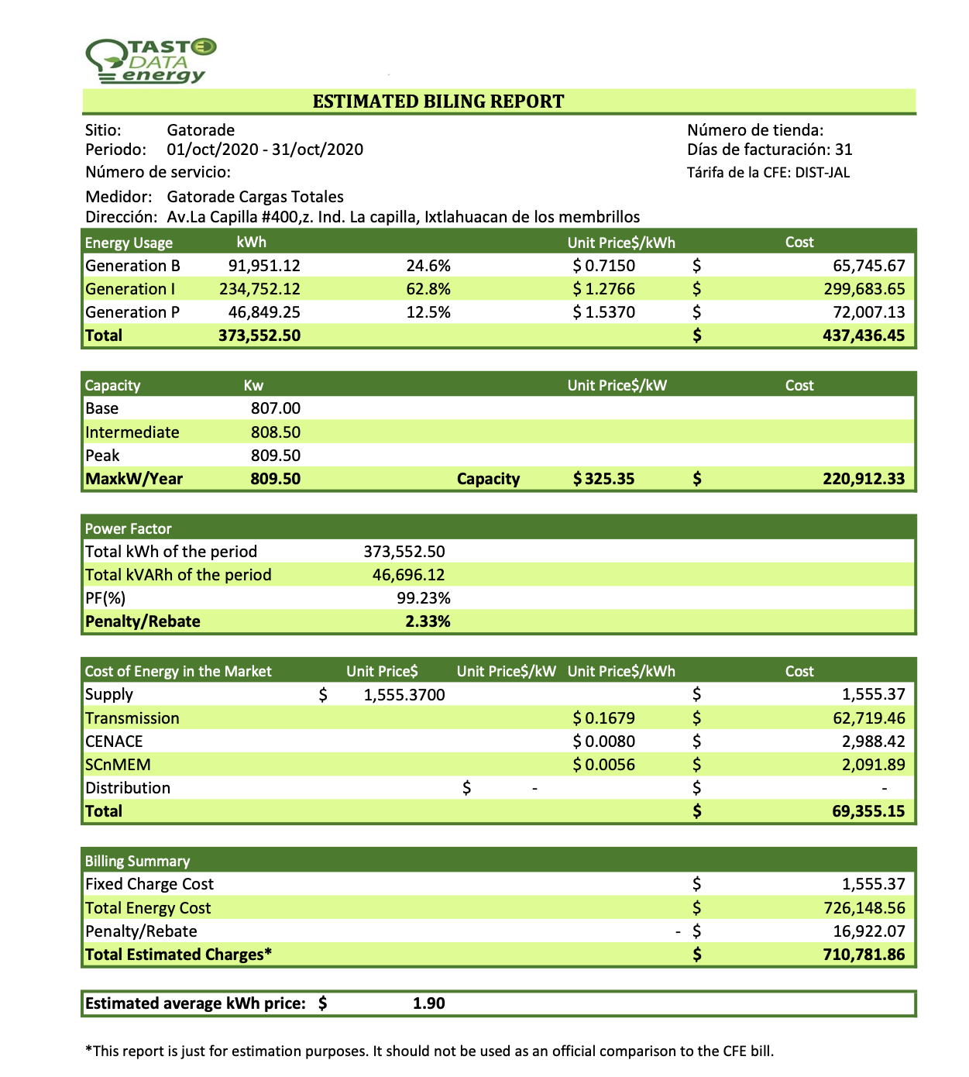

Slide 19
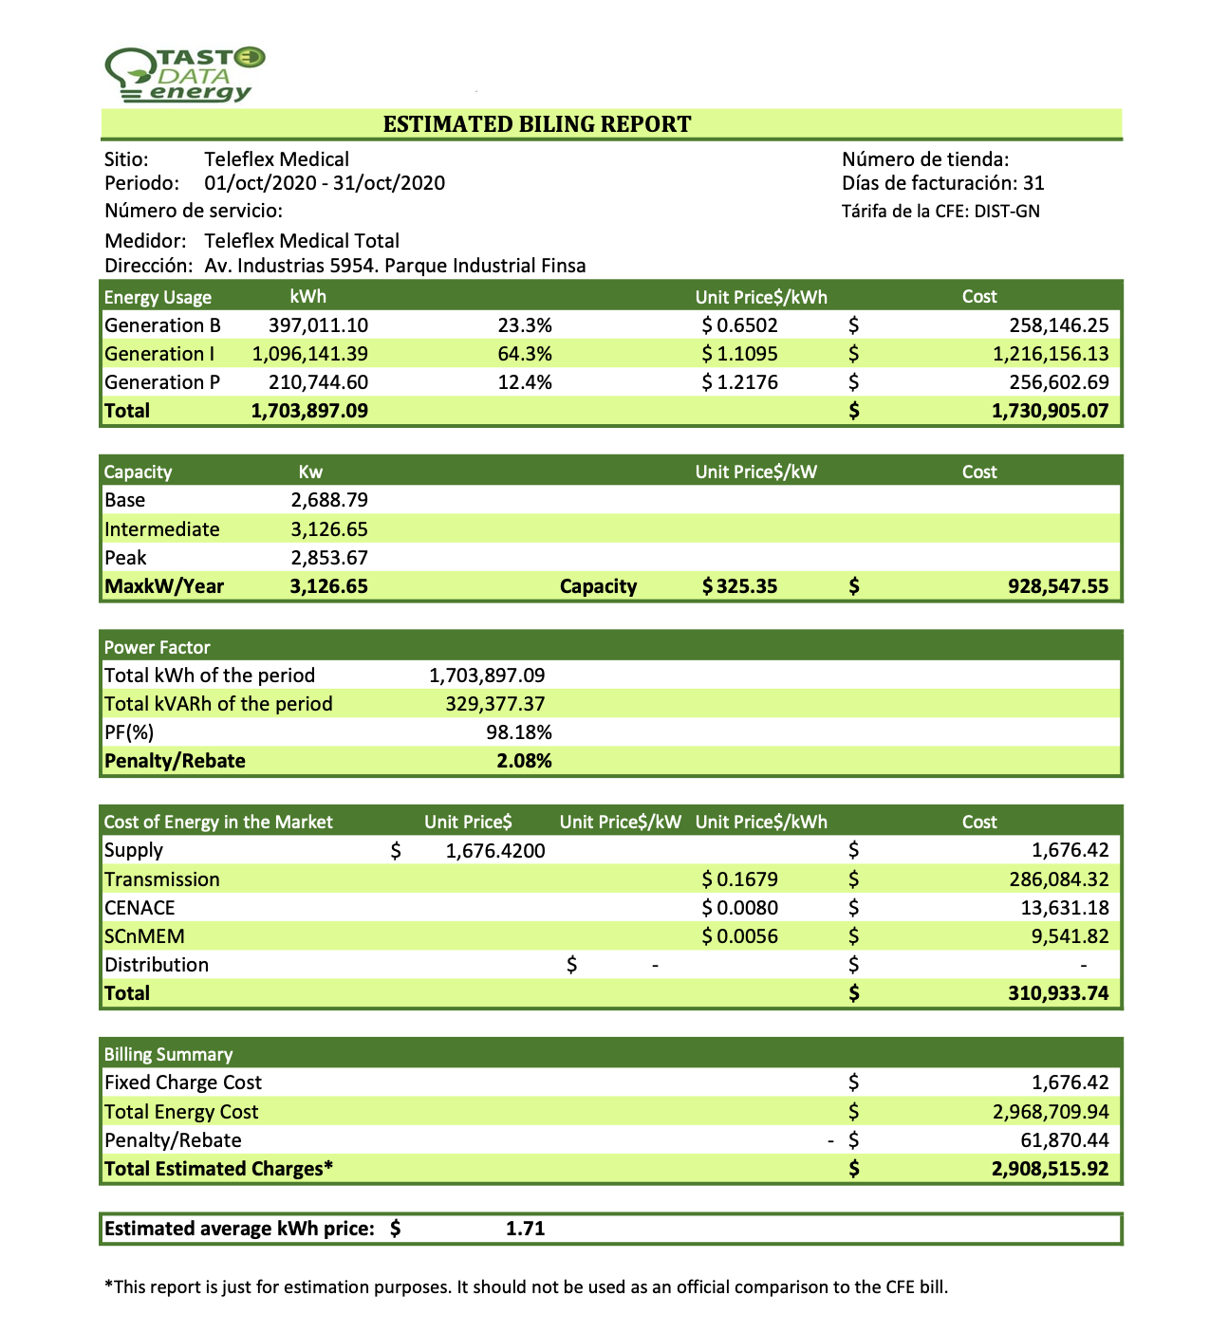

Slide 20
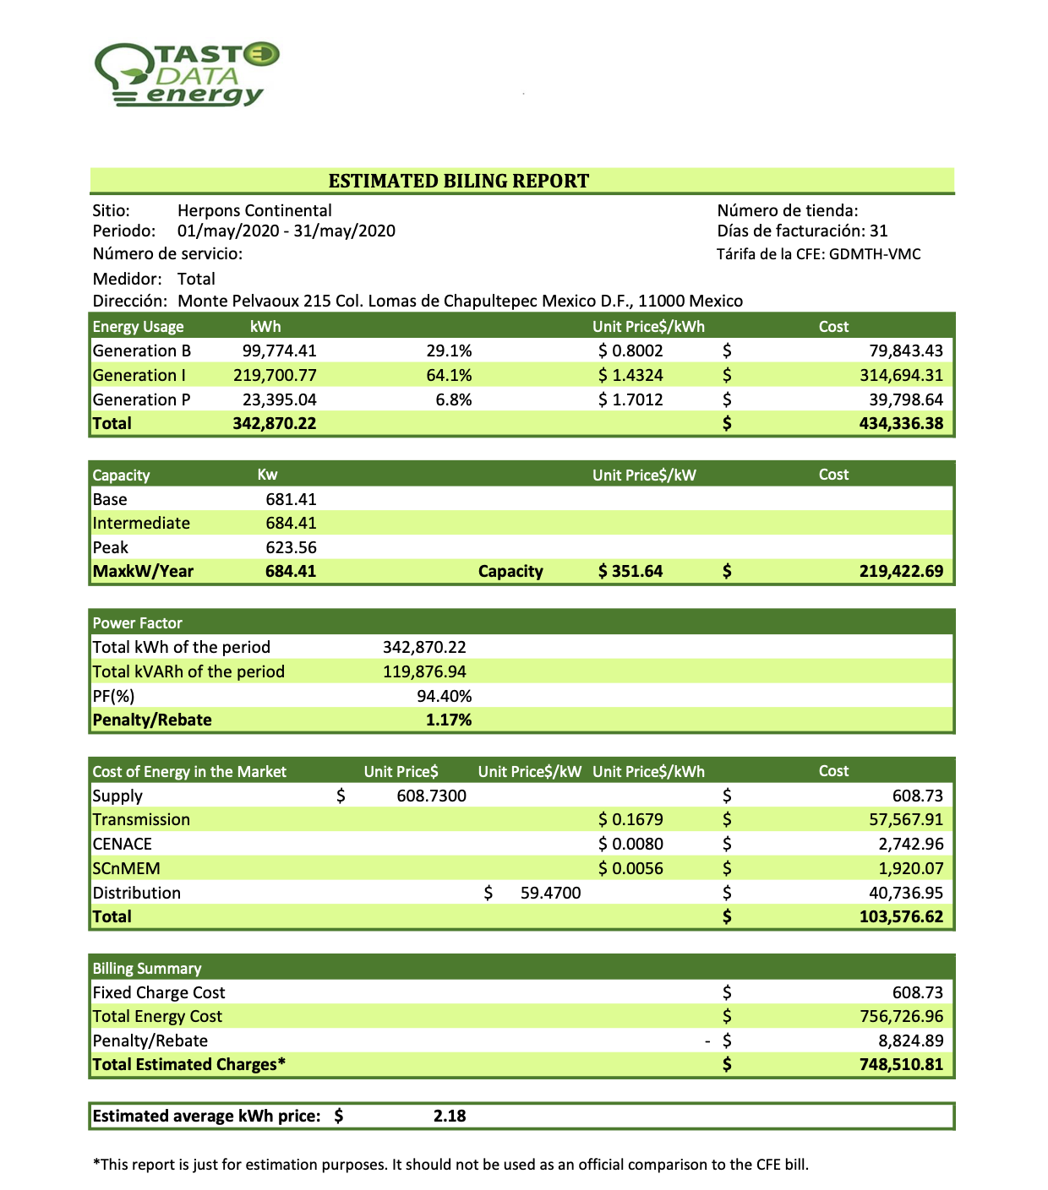

Slide 21
Use Cases
Models | Operating Hours | Hourly Consumption | Peak Shaving Rate | Peak Shaving Hours | Annual Savings in Mexican Pesos
Gatorade (Sports drink) | 24 | 0.778 MW | 0.7 | 6 | 953,101
Litoplas (store and bottled products for Nestle) | 24 | 0.714 MW | 0.65 | 7 | 925,735
Teleflex (Medical ) | 24 | 3.551 MW | 0.7 | 6 | 4,334,839

Slide 22
Model Comparison
Models | ME | MAE | MAPE
Our ARNN Model | -10.02 | 112.54 | 24%
Facebook Prophet | -4.57 | 148 | 26%
Direct LSTM | 62.70 | 187.26 | 41%
ARIMA | -335.80 | 335.80 | 60%
Direct CNN | 67.91 | 379.15 | 78%

